Slide 1
WHAT WE OFFER
Online / on-demand courses that develop job search skills through step-by-step course design presented in short, lively video units combined with quizzes and assignments to reinforce learning
Course content designed, facilitated and maintained by Career Professionals currently working with job seekers across North America
Flexibility to utilize the courses to suit your unique learner needs
The ability to monitor and report on learner progress via our LMS system
One stop branded LMS learning portal to centralize materials (e.g. student / graduate resumes)
www.eloftcareers.com ▪ info@eloftcareers.com
Notes:
Chandra
Note – make sure we integrate mention here of centralizing student / graduate resume via the use of assignments; ability for schools to review, comment, mark these documents, have students submit other materials (cover letter, STAR stories, etc)

Slide 2
CURRENT ONLINE,
ON-DEMAND COURSES
eLoft Careers offers 4 online, on-demand courses which cover the 4 pillars of job search:
Resumes that Win – 120 Minute Course (18 Video Units) plus 5-7 hours of quizzes, activities and homework leading to the completion of a resume
Standout Cover Letters – 70 Minute Course (7 Video Units) plus 3-4 hours of quizzes , activities and homework leading to the completion of a cover letter
Interview to Land Part 1 and 2 – Part 1 - 130 Minute Course (19 Video Units) plus 5-7 hours of quizzes, activities and homework leading to preparation for an interview + Part 2 - Video interview practice simulation with sample interviewee videos
Job Search Strategies and Networking Success – 130 Minute Course (18 Video Units) plus 5-7 hours of quizzes, activities and homework ensure learners understand how to conduct an effective job search.
www.eloftcareers.com ▪ info@eloftcareers.com
Notes:
Chandra

Slide 3
Consistent quality of service
BENEFITS
Redirect
Your Energy
Ensure consistent, standardized delivery of high-quality career services for all your students.
Redirect career services energy towards other top priority work including developing employer relationships, reviewing final applications and conducting mock interviews.
On-line /On-DEMAND
IMPROVE STUDENT OUTCOMES AND ENHANCE KPI RESULTS
Courses are available 24/7, 365 days a year on any device extending your regular office hours and fitting with the unique schedules of your learners.
Together these benefits will help your business to improve student/client outcomes and enhance KPI/job placement results.
www.eloftcareers.com ▪ info@eloftcareers.com
Notes:
Liz

Slide 4
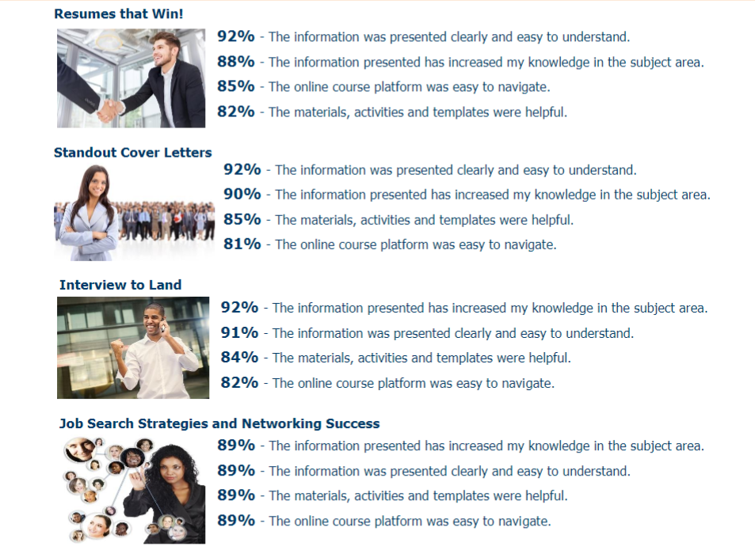
Percentage Of Career College Students that Responded
“Strongly Agree/Agree” on Course Satisfaction Survey
www.eloftcareers.com ▪ info@eloftcareers.com
Notes:
Chandra

