Slide 2
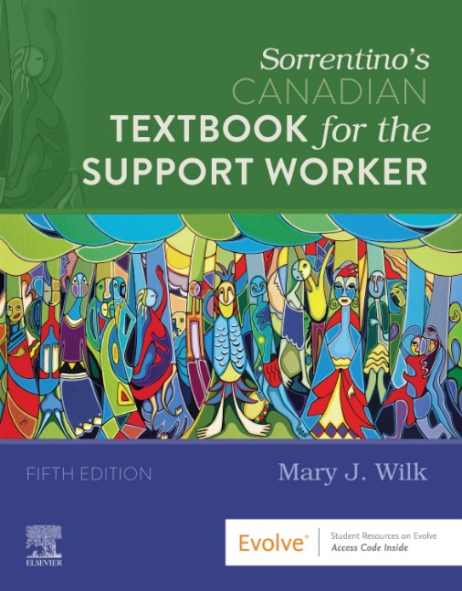
Mosby’s Canadian Textbook for the Support Worker
5th edition releases May 2021
New to this edition:
thoroughly updated content
enhanced illustrations
additional coverage of the PSWs scope of practice
more case studies and procedures
greater coverage of the roles played by other health team professionals

Slide 3
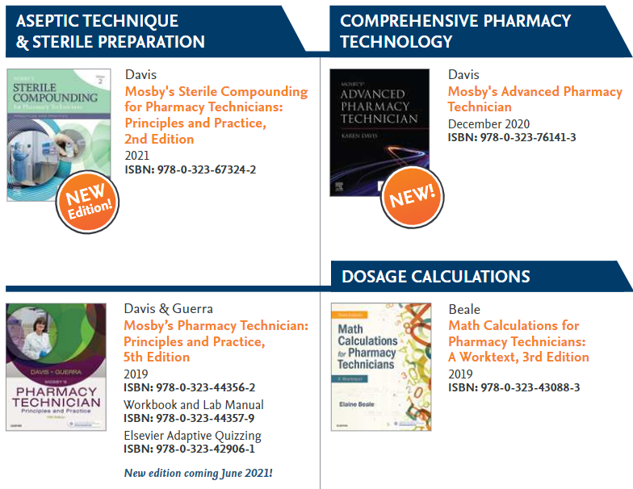
Pharmacy Technician

Slide 4
Your Elsevier Canada partners:
Colleen Thomson
c.thomson@elsevier.com
Melodee McPherson
m.mcpherson@elsevier.com

